Slide 1
ALM PTC Integrity

Slide 2








ITC Infotech ALM at a glance
8
Global Customer
15+ Dedicated
ALM Consultants
8
Projects Delivered
U&M
Centre of Excellence
Industry Verticals Served
Our Capability Differentiators
PTC Global Strategic Service Advantage Partner
Domain and Process led Consulting Approach
Widest PTC product family integration expertise across modules
Assured Service Delivery capability backed by standard tools & templates
One of the largest pool of trained resources on PTC Integrity within PTC partner ecosystem
Automotive
Industrial
Hi-Tech
Aerospace & Defense

Slide 3
ALM Practice Overview
Capability
Competence
Credentials
Requirement
Management Enablement
Domain Consultants
Requirement mgmt. Automation for Global Auto OEM
Software Configuration Management Enablement
Product Specialists
Requirement Mgmt. tool migration for global Energy System Integrator
Integrated System Engineering for Automotive OEM
Application Lifecycle Management Enablement
Model Based System Engineering Enablement
Migration Specialists
Enabled System Engineering for Industrial Major
System Test Management
System Integration Specialists
ALM tool migration
for Global High-Tech manufacturer
Integrated System Engineering
Enablement
IOT Support System Enablement
Automotive
Medical
Device
Focus Area
ALM Reporting and Analytics Enablement
High Tech
Industrial
Aerospace and Defence
Capability
Under
Development

Slide 4

ALM Service Offering Portfolio
Consulting
Implementation
Upgrade & Migration
Need Assessment
Product Evaluation & Selection
Product Deployment Roadmap
Application Portfolio Rationalization
System Configurations
Application Customization
Training & Adoption
Performance Tuning
System Upgrade
Legacy System Migration
Enterprise System Migration
Run-team Support
Shared Service Support
Packaged Support
Application Support
Integration
Next Gen ALM
ALM Integration with PLM systems
ALM platform Integration with
Application development tools
Integrated System Engineering
Model Based System Engineering
IOT support platform enablement

Slide 5
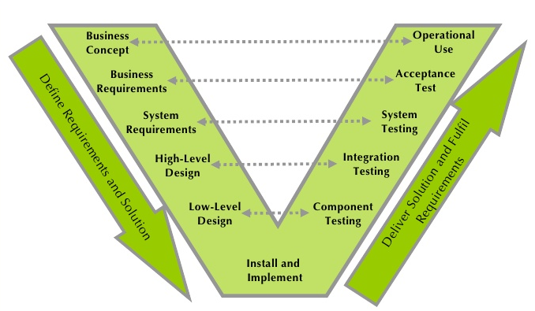
System Engineering Approach: Product Development
Approach Requirement:
Followed almost by all organization
Seamless Integration across functions
Bi Directional traceability
Closed loop Process enablement
NPD frameworks Compliance
TS / ISO / ASPICE/ CMM
Current Challenges:
Point based solution enabling functional silos
Lost bi directional traceability
Process discontinuity across functions
NPD framework compliance on paper
Enabling Mechatronic environment, how??
Best Practice deployment??
Organizational Need

Slide 6
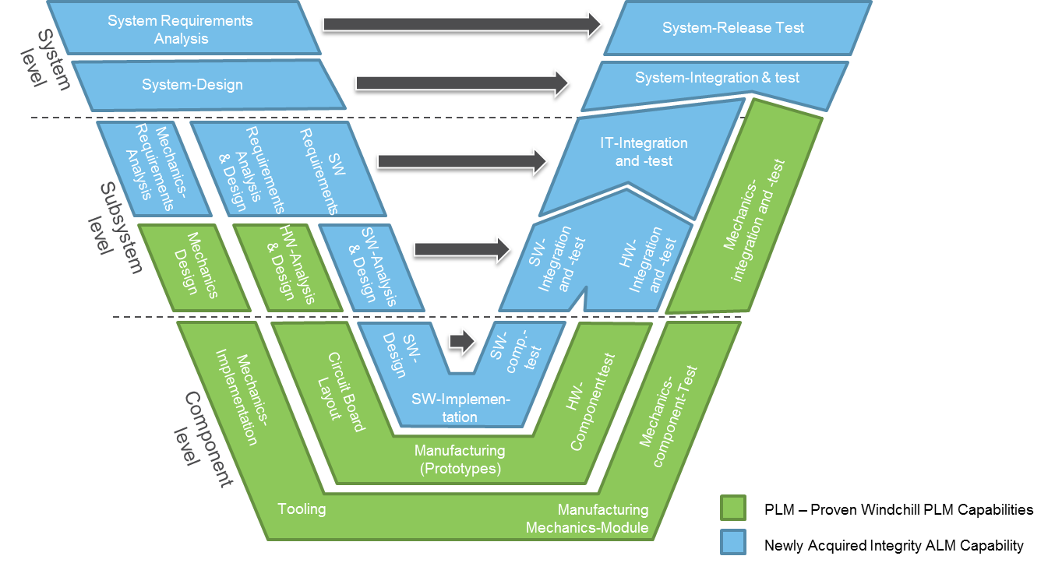
System Engineering Enablement: Windchill- Integrity Integration:

Slide 7
Interface Microsystem: Project Objective, Approach and Scope
Objective/ Goal:
Enable System Engineering approach for
product development
Enable ASPICE Level 3 compliance for Software
Development processes
Enable ISO 26262 (Product Safety)
Project Scope
Requirement Management
Managing Requirement Life cycle
Closed loop Requirement Traceability
Software Life cycle Management
Source Code Management
Software Configuration Management
Build/Release/Deployment Management
Test Management
Issue and Defect Management
Test Plan, Test case, Test Result Management
Enterprise Integration with
Windchill PDMlink
Development Platform- ECLIPSE, Visual Studio
ASPICE 3 level / ISO26262 standards Compliance
How:
Deploy Application Life Cycle Management System
Integration with NPD platform (Windchill)
Enable System driven Product Safety life cycle Mgmt.

Slide 8
Automotive SPICE Process Reference Model
A- Automotive
S- Software
P- Process
I- Improvement
C- Capability
E- Determination
ASPICE PRM Framework : Process Life Cycle- Process Groups-Processes

Slide 9

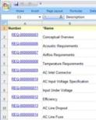

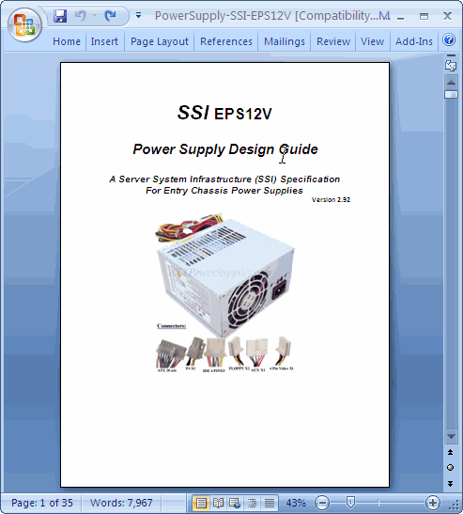


Windchill 10.1 Requirements Management Integration
An integral part of Windchill
Define & Capture Requirements
Trace Requirements
Verify Requirements
Collaborate on Requirements
Report on Requirements
Control Requirements
Tailor for Specific Needs
Derive
Specification
Allocate
End Item
Specification
Export, Update & Import
Requirement
End Item or Part
Section
Derive
Allocate
Part
Requirement
Requirement
Requirement
Part
Section
Satisfy
End Item or Part
Section
Requirement
Requirement
Part
Export, Update & Import
Requirement
Requirement
Part
Requirement
Verification
Document
Requirement A.2
Change
Verify
Verification
Satisfy
Requirement B.1
Part
Document

Slide 10
Product Scope: Windchill PDMlink/ PTC Integrity
Windchill PDMlink:
Focused on Mechanical/ Electrical/ Electronics products
BOM Management
CAD Data Management
Document Management
Design Change Management
Project Management
PTC Integrity:
Focused on Application life cycle Management
Requirement Management
Test & Defect Management
Software Data Management
Software Change Management
Software Configuration Management
Software Build/ Deployment Management
Project Management
Key Business Drivers: Windchill Deployment and Usage
Product Life Cycle Management
Key Business Drivers: PTC Integrity Deployment and Usage
Requirement Life cycle Management
Test and Defect Life cycle Management
Software Data and Configuration Management

Slide 11
Business Benefits:
Integrated Product Development Environment eliminates functional silos and inefficiencies
Achieving ASPICE Level III Compliance- Exceeding/ Meeting OEM Requirements
Software Development process best practice enablement
Automation of ISO 26262 standard compliance

